Slide 1
General Revision
Lectures 4 to 25

Slide 2
Malware && DoS/DDoS

Slide 3
Lecture Objective
Identify the most common types of threats and Attacks as well as defence mechanisms:
Viruses
Worms (Focus)
Trojan Horses
Spyware
DoS and DDOS (Focus)

Slide 4
Viruses vs. worms
VIRUS
Propagates by infecting other programs
Usually inserted into host code (not a standalone program)
E.g., MS macros…
Generally requires human intervention
WORM
Propagates automatically by copying itself to target systems
Is a standalone program
No human intervention needed

Slide 5
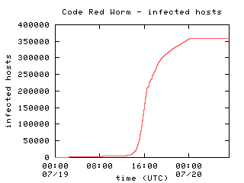
Why worry about worms?
Worms can be fast
Code Red required ~13 hours to spread worldwide
Other techniques can be even faster
Eg, “Warhol Worm” → 15 minutes
Slammer → 10 minutes
Faster than human reaction
Worms can have highly malicious payloads
DDoS
Data corruption
Graph from David Moore's analysis (caida.org)

Slide 6
DoS and DDoS
Denial of Service (DoS) and Distributed Denial of Service (DDoS) attacks tie up the network with too much traffic
They do not steal or corrupt data; they bring down the network in order to cost them money
Hackers use Bots/logic bomb (specific date/specific time)

Slide 7



Typical DDoS setup circa/around 2005
Attacker’s machine
Masters
(Handlers)
Slaves
(Agents)
Infection/recruitment
Command & control
Assault
Victim
Notes:
Circa/around

Slide 8
Modern Botnet setup
Zombies
(P2P)
Attackers
Attackers
Attackers
Peer-to-peer communication
Command & control
Assault
Victim

Slide 9
DDoS challenges
Higher complexity
Hard to defend against
Greater distance from victim to attacker
Hard to trace back
Offensive capabilities of single attacker multiplied
Can be sized dynamically
Toolkits make this easy

Slide 10
SDN & Net Security

Slide 11
Why SDN ?
With traditional network, one box contains every thing: hardware, software, firewall… if power goes off everything is down!
SDN separates (pulls) intelligent from hardware.
SDN Creates management system to make the overall networking system much more intelligent.

Slide 12
SDN controllers might be designed in
Hierarchy
Network Operating System (controller)
Network Operating System (controller)
Network Operating System (controller)
Network Operating System (controller)
Network Operating System (controller)
Network Operating System (controller)
Network Operating System (controller)
Forwarding device
Forwarding device
Forwarding device
Forwarding device
Forwarding device
Forwarding device

Slide 13
South-Bound Interface
OpenFlow (Open flow is a control protocol that helps communication between data and control plans)
OVSDB
NETCONF
SNMP

Slide 14



OpenFlow Operation
L2 Forwarding application
Controller
(e.g., NOX)
SDN Controller
(2)
(3)
(1)
(4)
(5)
SDN Switch
Host A
Host B
A → B: Forward
Flow Table in SDN Switch

Slide 15






Threat vectors map
Threat vector 1
forged or faked traffic flows
SDN Controller
Admin
Station
Control & Management
SDN device
SDN device
SDN device
Data Plane
SDN device
1
Not specific to SDNs, but can be a door for augmented DoS attacks.
Possible solutions: IDS + rate bounds for control plane requests

Slide 16
Threat vectors map
Threat vector 2
exploiting vulnerabilities in forwarding devices
SDN Controller
Admin
Station
Control & Management
SDN device
2
SDN device
SDN device
Data Plane
SDN device
Not specific to SDNs, but now the impact is potentially augmented.
Possible solutions: software attestation with autonomic trust management

Slide 17
Threat vectors map
Threat vector 3
attacking control
communications
SDN Controller
Admin
Station
Control & Management
3
SDN device
SDN device
SDN device
Data Plane
SDN device
Specific to SDNs: communication with logically centralized controllers can be explored.
Possible solutions: threshold cryptography across controller replicas

Slide 18
Threat vectors map
Threat vector 4
exploiting vulnerabilities in controllers
4
SDN Controller
Admin
Station
Control & Management
SDN device
SDN device
SDN device
Data Plane
SDN device
Specific to SDNs, controlling the controller may compromise the entire network.
Possible solutions: replication + diversity + recovery

Slide 19
Threat vectors map
Threat vector 5
lack of trust between the controller and apps
5
SDN Controller
Admin
Station
Control & Management
SDN device
SDN device
SDN device
Data Plane
SDN device
Specific to SDNs, malicious applications can now be easily developed and deployed on controllers.
Possible solutions: software attestation, security domains

Slide 20
Threat vectors map
Threat vector 6
Attack on vulnerability in administrative station
6
SDN Controller
Admin
Station
Control & Management
SDN device
SDN device
SDN device
Data Plane
SDN device
Not Specific to SDNs, by compromising the critical computer, the controller could be easily attacked.
Possible solutions: replication + recovery

Slide 21
IDS & IPS

Slide 22
Goals
Understanding IDS and IPS
Understanding the difference between IDS and IPS
Where to deploy IDS and IPS
Pros and Cons
Research direction

Slide 23
IDS VS. IPS
IDS
IPS
Intrusion Detection
Passive device
-Collect Data
-does not interrupt a session
Intrusion Prevention
Active device
Collect Data
Does interrupt a session
Probe
Succeeds
IDS
Detects
Attack
Client
Server
IP address: 192.1.2.2

Slide 24
Probe
Succeeds
IDS
Detects
Attack
Client
Server
IP address: 192.1.2.2
IPS Rule Update
Shun: 192.1.2.2
IPS Shuns
Client
Server
Client

Slide 25
side channel Attack

Slide 26
What is a side channel Attack(SCA)?
Attacks based on “implementation” of a system
Not brute-force or theoretical weaknesses
Unintentional “features”
Notes:
Side channel attack (SCA) is an any attack based on information gained from physical implementation of a crypto system/ devices or the nature of links

Slide 27
What is a side channel?
Two phases:
Monitoring/measuring chip’s physical characteristics(Power, current, timing. EM radiation, etc.) during its normal operation
Perform data analysis to learn information
Features
SCA are non-invasive and passive.
May combine with other active attack methods
Use some inputs to control the normal operation
Force abnormal operation (ex. fault injection)
Notes:
Non-invasive, because there is no requirement to open the device or chip. Passive because they do not require direct physical contact for performing attack

Slide 28
Types of side channels (Crypto)
Timing attack - how much time computations take.
Power-monitoring attack -- varying hardware power consumption.
Electromagnetic attacks leaked EM radiation
Acoustic cryptanalysis: sound produced during a computation (rather like power analysis).
Differential fault analysis: inducing faults
Data remanence: data are read after supposedly having been deleted.

Slide 29
Sources of Side channel
Measurable physical features
Power consumption
Timing or delay EM radiation
Optical
Acoustic
Output signals

Slide 30
Types of side channels (netsec)
“Control” traffic – e.g., DNS
Inter-arrival of packets
Packet sizes
Packet sequence signatures/connection patterns
“Graph” of communications
Counts/volume
Content similarity
Protocol side effects – e.g., caching, AJAX, error msges, fast-path vs slow path etc
Notes:
Netsec-----network security

Slide 31
Firewalls

Slide 32
Goals
Better understanding of what a firewall is.
Understand different firewall types.
Understand where firewalls fit.
Getting idea of research trends

Slide 33
Which Firewall to use?
0- Unacceptable
1- Minimal Security
2- Acceptable
3- Effective
4- Recommended
Firewall type | High Risk Environment(e.g., Hospital) | Medium Risk Environment (e.g., University) | Low Risk Environment (Florist shop)
Packet filtering
Proxy
Hybrid

Slide 34
Which Firewall to use?
0- Unacceptable
1- Minimal Security
2- Acceptable
3- Effective
4- Recommended
Firewall type | High Risk Environment(e.g., Hospital) | Medium Risk Environment (e.g., University) | Low Risk Environment (Florist shop)
Packet filtering | 0 | 1 | 4
Proxy | 3 | 4 | 2
Hybrid | 4 | 3 | 2

Slide 35
ACLs

Slide 36
ACLs Concepts _Key topics
What are ACLs
How ACLs Work
Creating ACL
Verifying ACLs
The function of a wildcard mask
Standard ACLs
Extended ACLS
Placing ACLs
Restricting virtual terminal access
access-class

Slide 37
DNS & DNSSEC

Slide 38
Goals of this lecture
Overview of DNS
Understand DNS attacks
DNSSec protocol

Slide 39
DNS vulnerabilities
Complete lack of authentication primitives
Can redirect all DNS requests to a compromised server
Can have a legitimate server send bogus replies
Two techniques
DNS cache poisoning
DNS ID spoofing

Slide 40

DNS cache poisoning
1. What is the IP of www.attacker.net?
Attacker
(host.whatever.com)
4. What is the IP of MyBank.com?
5. MyBank.com = 10.0.1.1
2. What is the IP of www.attacker.net?
DNS server
dns.victim.com
Victim
(host.victim.com)
3. www.attacker.net = 10.12.1.1
ZONE TRANSFER:
…
MyBank.com = 10.0.1.1
…
Attacker
(Rogue DNS server)
dns.attacker.net

Slide 41
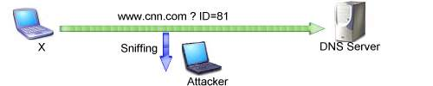

DNS ID spoofing
Easy to do when sniffing network
Limit of this attack?
Depends on winning the race … which is not too hard with ARP poisoning

Slide 42
DNS Security Extensions
Uses public key cryptography to verify the authenticity of DNS zone data (records)
DNSSEC zone data is digitally signed using a private key for that zone
A DNS server receiving DNSSEC signed zone data can verify the origin and integrity of the data by checking the signature using the public key for that Zone

Slide 43
Take away slide
DNS built upon assumption people will behave normally
Therefore highly vulnerable to attacks
DNS attacks can allow an attacker to do pretty much whatever she wants with your traffic
Almost no one uses IP addresses…
DNS recursion is the root of the problem
Unfortunately, very convenient and hard to disable
DNSSec Provides security:
Resources Records Digitally Signed
Recursive resolver validates
Data integrity and origin authentication

Slide 44
Symmetric and Asymmetric encryption

Slide 45
Learning Objectives
To introduce Symmetric encryption
Understand Classical and modern Encryption Techniques
To introduce Asymmetric encryption
Introduce one-way function
To discuss the RSA cryptosystem
To distinguish between two cryptosystems: symmetric-key and asymmetric-key

Slide 46
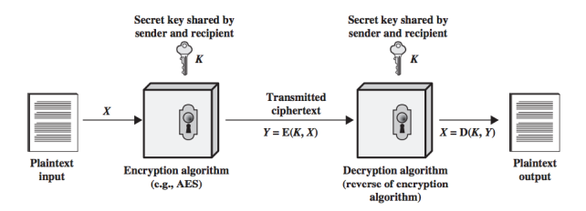
Symmetric Cipher Model
A cryptographic technique where both parties in the communication share the same key
Source: https://notes.shichao.io/cnspp/ch2/

Slide 47
Simplified AES Example
Encryption
Key(256-bits)
Plaintext Data(128-bits)
AES-E
Ciphertext (128-bits)
Key(256-bits)
Decryption
Ciphertext (128-bits)
AES-E
Plaintext Data(128-bits)

Slide 48
Asymmetric-Key Cryptography
Also known as public-key cryptography, performs encryption and decryption with two different keys.
Each node announces its public key and then uses its own private key to encrypt messages. Other nodes can decrypt the node with the public key.
Only the specific public key of a node can be used to decrypt a message encrypted with that node’s private key.
Messages can be authenticated, kept private and the content proven to be correct through this method.

Slide 49
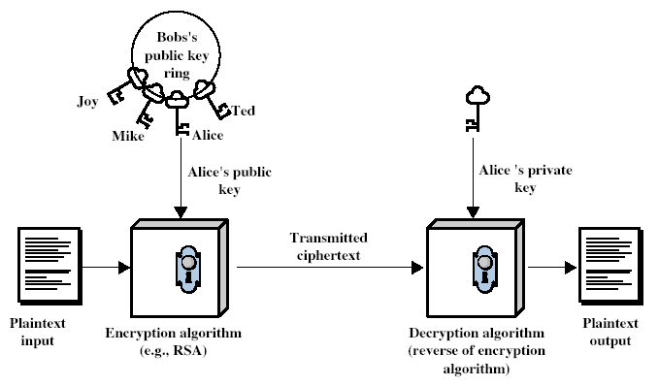
Public-Key Cryptography
Notes:
Stallings Fig 9-1.

Slide 50
RSA Key Setup
Each user generates a public/private key pair by:
Selecting two large primes at random - p, q
Computing their system modulus N=p.q
note ø(N)=(p-1)(q-1)
Selecting at random the encryption key e
where 1<e<ø(N), gcd(e,ø(N))=1
Solve following equation to find decryption key d
e.d mod ø(N)=1 and 0≤d≤N
Publish their public encryption key: Kp={e,N}
Keep secret private decryption key: Ks={d,p,q}
Notes:
This key setup is done once (rarely) when a user establishes (or replaces) their public key. The exponent e is usually fairly small, just must be relatively prime to ø(N). Need to compute its inverse to find d. It is critically important that the private key KR={d,p,q} is kept secret, since if any part becomes known, the system can be broken. Note that different users will have different moduli N.

Slide 51
RSA Use
To encrypt a message M the sender:
obtains public key of recipient Kp={e,N}
computes: C=Me mod N, where 0≤M<N
To decrypt the ciphertext C the owner:
uses their private key Ks={d,p,q}
computes: M=C^{d} mod N
Note that the message M must be smaller than the modulus N (block if needed)

Slide 52
Data integrity algorithms

Slide 53
Goals of this lecture
Introduce H-function and its use
Public key distribution?
Diffie-Hellman key exchange
Certification authority
Understand Digital signature:
Concept,
key generation,
signing and
verification

Slide 54
Introduction
Based on the difficulty of computing discrete logarithms of large numbers.
No known successful attack strategies*
Requires two large numbers, one prime (P), and (G), a primitive root of P

Slide 55
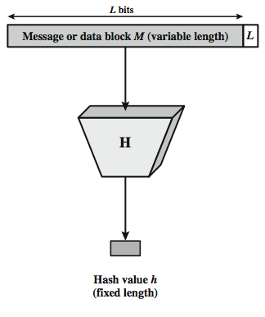
Cryptographic Hash Function
Notes:
Stallings Figure 11.1 depicts the general operation of a cryptographic hash function. Typically, the input is padded out to an integer multiple of some fixed length (e.g., 1024 bits) and the padding includes the value of the length of the original message in bits. The length field is a security measure to increase the difficulty for an attacker to produce an alternative message with the same hash value.
55

Slide 56
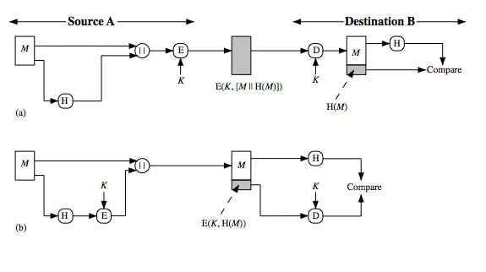
Hash Functions & Message Authentication
Symmetric Key
Unkeyed Hash
Message
encrypted
b) Message
unencrypted
Notes:
56
Message authentication is a mechanism or service used to verify the integrity of a message, by assuring that the data received are exactly as sent. Stallings Figure 11.2 illustrates a variety of ways in which a hash code can be used to provide message authentication, as follows:
The message plus concatenated hash code is encrypted using symmetric encryption. Since only A and B share the secret key, the message must have come from A and has not been altered. The hash code provides the structure or redundancy required to achieve authentication.
Only the hash code is encrypted, using symmetric encryption. This reduces the processing burden for those applications not requiring confidentiality.
Shows the use of a hash function but no encryption for message authentication. The technique assumes that the two communicating parties share a common secret value S. A computes the hash value over the concatenation of M and S and appends the resulting hash value to M. Because B possesses S, it can recompute the hash value to verify. Because the secret value itself is not sent, an opponent cannot modify an intercepted message and cannot generate a false message.
Confidentiality can be added to the approach of (c) by encrypting the entire message plus the hash code.
When confidentiality is not required, method (b) has an advantage over methods (a) and (d), which encrypts the entire message, in that less computation is required.

Slide 57
Public key certificates
A public key certificate is a set of data that binds an identity to a particular public key value. The four core pieces of information that are contained in a public key certificate are as follows:
Name of owner
could be a person, device, or even role.
Should uniquely identify the owner within the environment in which the public key will be employed.
Public key value
Validity time period
identifies date and time from which the public key is valid, and more importantly the date and time of its expiry.
Signature
Creator of certificate digitally signs all data that forms the public key certificate. This binds the data and acts as a guarantee that the creator of the certificate believes the data is correct.

Slide 58
Digital Signatures
digital signatures provide the ability to:
verify author, date & time of signature
authenticate message contents
be verified by third parties to resolve disputes
hence include authentication function with additional capabilities
Notes:
The most important development from the work on public-key cryptography is the digital signature. Message authentication protects two parties who exchange messages from any third party. However, it does not protect the two parties against each other either fraudulently creating, or denying creation, of a message. A digital signature is analogous to the handwritten signature, and provides a set of security capabilities that would be difficult to implement in any other way. It must have the following properties:
• It must verify the author and the date and time of the signature
• It must to authenticate the contents at the time of the signature
• It must be verifiable by third parties, to resolve disputes
Thus, the digital signature function includes the authentication function.

Slide 59
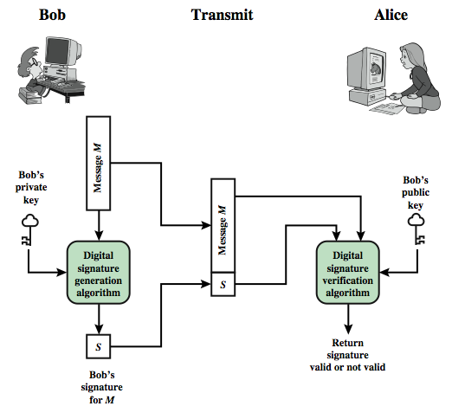
Digital Signature Model
Notes:
Stallings Figure 13.1 is a generic model of the process of making and using digital signatures. Bob can sign a message using a digital signature generation algorithm. The inputs to the algorithm are the message and Bob's private key. Any other user, say Alice, can verify the signature using a verification algorithm, whose inputs are the message, the signature, and Bob's public key.

Slide 60
OSI Layer 3 VPN (IPSec)

Slide 61
Lecture Goals
Understand:
Why we use IP Security (IPSec)
IP Security Components
IP Security Architecture
Pros and cons of IP Security

Slide 62
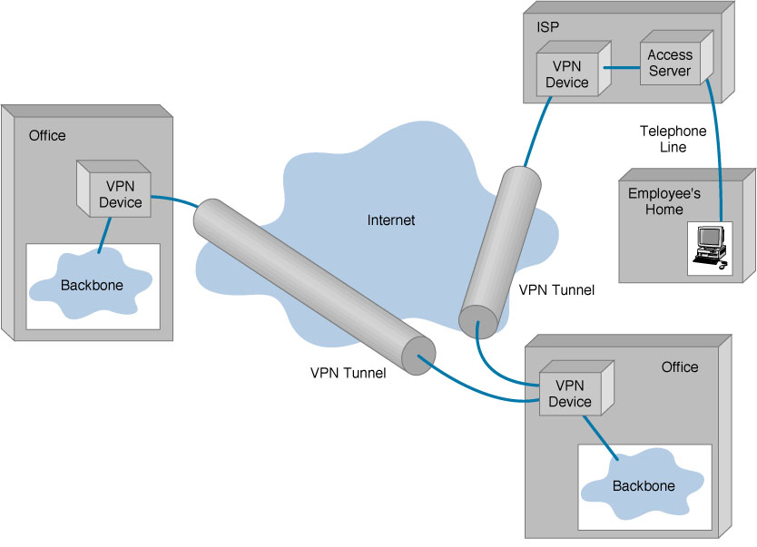
Virtual Private Networks (VPN) Basic Architecture

Slide 63
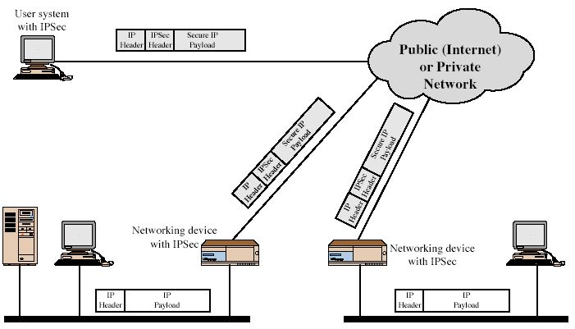
IPSEC view of data packets
Notes:
Stallings Figure 16.1 illustrates a typical IP Security scenario. An organization maintains LANs at dispersed locations. Nonsecure IP traffic is conducted on each LAN. For traffic offsite, through some sort of private or public WAN, IPSec protocols are used. These protocols operate in networking devices, such as a router or firewall, that connect each LAN to the outside world. The IPSec networking device will typically encrypt and compress all traffic going into the WAN, and decrypt and decompress traffic coming from the WAN; these operations are transparent to workstations and servers on the LAN. Secure transmission is also possible with individual users who dial into the WAN. Such user workstations must implement the IPSec protocols to provide security.
Security Associations
A one-way relationship between sender & receiver that affords security for traffic flow
Can be between
A pair of hosts
A host and a security gateway
A pair of security gateways

Slide 64
IPSec Components
Protocols:
AH
ESP
Key Management:
Manual / IKE
Algorithms:
Encryption and
Authentication
Security Association (SA)

Slide 65


Protocols
Provides an encapsulation for authentication of user traffic.
AH
Provides an encapsulation for encryption and authentication of user traffic
ESP
Notes:
AH can provide integrity check but it doesn’t provide encryption. Not popular any more!
ESP provides both integrity and authentication.
--→ Why AH still exist? Bcz it provides ISP integrity check between routers(GWs)

Slide 66
Authentication Header (AH)
Data integrity
Entire packet has not been tampered with
Authentication
Can “trust” IP address source
Anti-replay feature
Integrity check value
Notes:
Use MAC to authenticate Symmetric encryption, e.g, DES One-way hash functions, e.g, HMAC-MD5-96 or HMAC-SHA-1-96
Key Exchange: Diffie-Hellman
􀁻Encryption: DES-CBS
􀁻Authentication: HMAC

Slide 67
ESP (Encapsulating Security Payload)
ESP allows for encryption, as well as authentication.
Both are optional, defined by the SPI and policies.
ESP does not protect the IP header, only the payload
But, in tunnel mode everything is encapsulated
If ESP encryption is enabled, then everything after the ESP header is encrypted
Communication protocol, ports (NATs and firewalls need IP Header information).

Slide 68
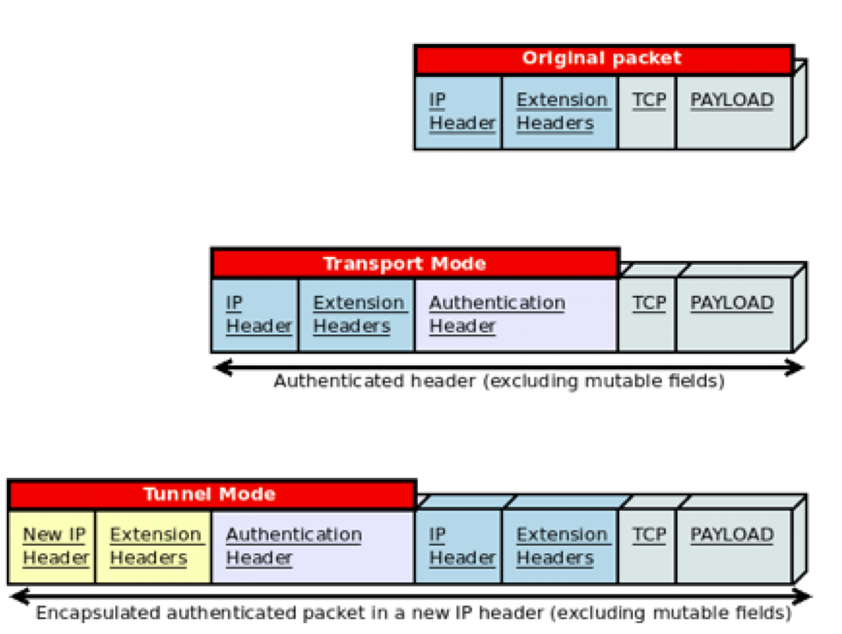
AH: Transport Mode Vs Tunnel Mode
https://www.redhat.com/sysadmin/ipv6-packets-and-ipsec

Slide 69
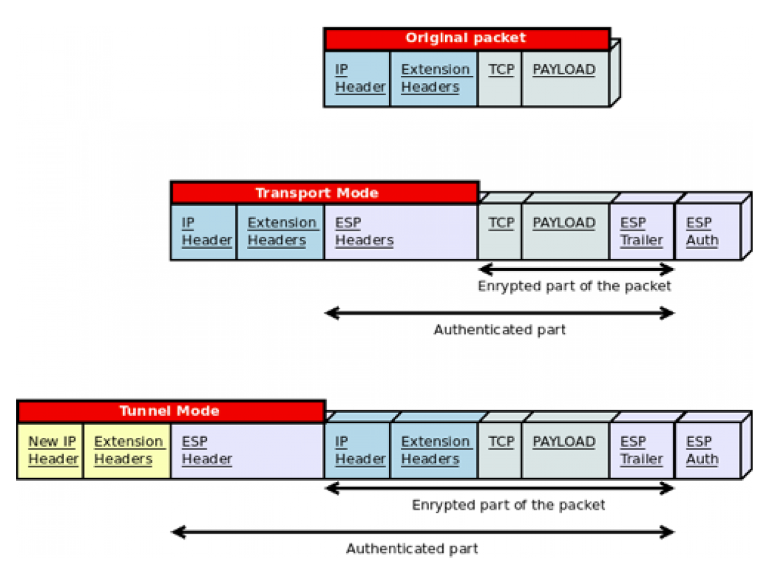
ESP: Transport Mode Vs Tunnel Mode
https://www.redhat.com/sysadmin/ipv6-packets-and-ipsec

Slide 70
IKE (Runs over UDP to destination port 500)
IKE Phase 1
IKE Phase 2
Creates an IKE SA (Main Mode or Aggressive Mode)
Peers negotiate a secure, authenticated key-management channel through Internet Security Association and Key Management Protocol (ISAKMP)
Creates IPsec SAs (Quick Mode)
Ipsec SAs are negotiated to protect user traffic.
IPSec Profiles (Outbound & Inbound )
Each SA has a different Security Parameter Index (SPI)

Slide 71
OSI Layer 4 Security (SSL & TLS)

Slide 72
Where does SSL fits?
PoP3
110
HTTP
80
SMTP
25
SPoP3
995
HTTPS
443
SSMTP
465
SSL or TLS
Transport
Network
Data link

Slide 73
SSL Components
SSL Handshake Protocol
Negotiation of security algorithms and parameters
Key exchange
Server authentication and optionally client authentication
SSL Record Protocol
Fragmentation
Compression
Message authentication and integrity protocol
Encryption

Slide 74
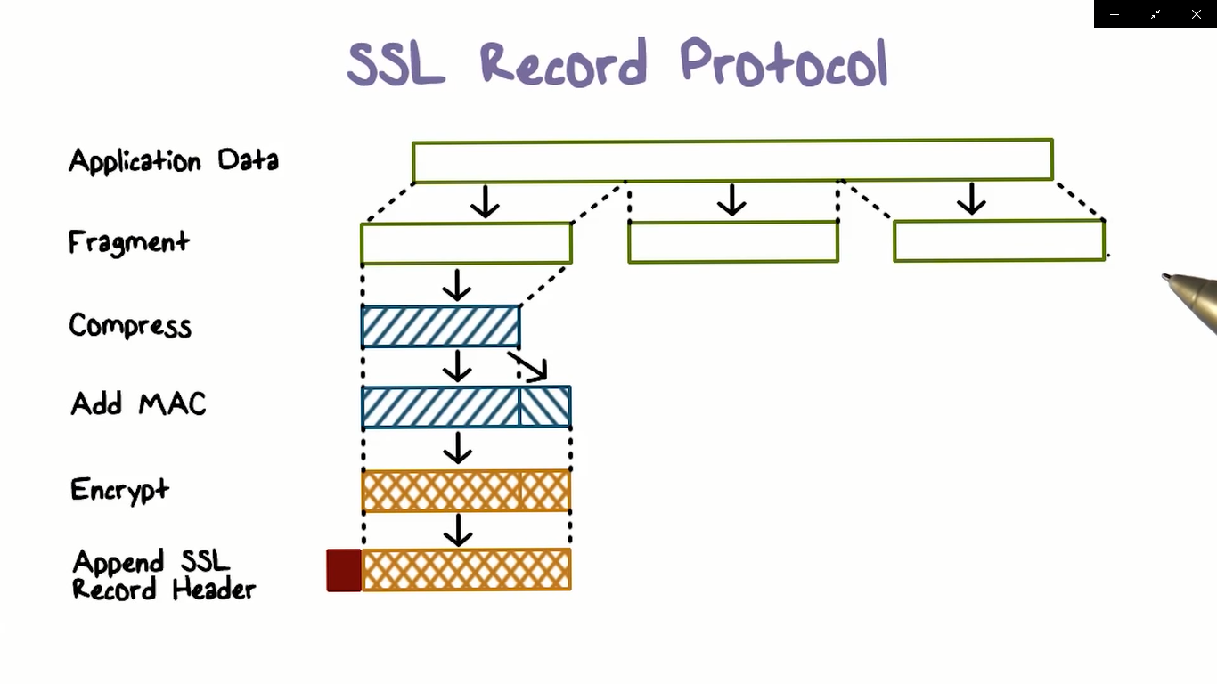

Slide 75
Transport Layer Security(TLS)
Designed for providing security at the transport layer.
TLS was derived from SSL
TLS ensures privacy between communication applications and their users on the Internet
TLS is widely deployed protocol for securing client-server communications over the Internet

Slide 76
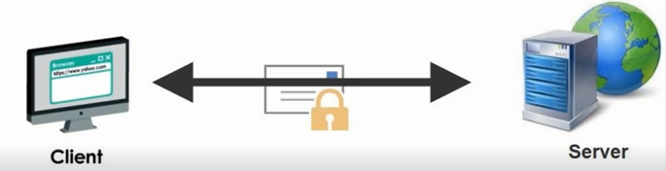
TLS handshake protocol
SS/TLS basically used between client and web server to establish trust and the negotiate what secret key should be used to encrypt and decrypt the conversation.

Slide 77
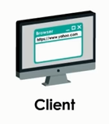

TLS handshake protocol
All steps
ClientHello
ServerHello
ClientKeyExchange
Finished(Client)
Finished(Server)
Exchange Messages

Slide 78
Routing Security – BGPSec

Slide 79
Goals of this lecture
Quick overview of BGP
Understand problems in inter-domain routing
Understand S-BGP
Appreciate “deployability” requirements

Slide 80
Autonomous System (AS)
AS 100
Collection of networks with same policy
Single routing protocol
Usually under single administrative control
IGP to provide internal connectivity
Notes:
IGP: Interior Gateway Protocol

Slide 81
We need path validating protocols
soBGP: Secure origin BGP
Origin authentication +
…Trusted database that guarantees that a path exists
ASes jointly sign + put their connectivity in the DB
Stops ASes from announcing paths with edges that do not exist
What challenges might soBGP face for deployment?
S-BGP: Secure BGP
Each AS on the path cryptographically signs its announcement
Guarantees that each AS on the path made the announcement in the path.

Slide 82
S-BGP design overview
IPsec: authenticity and integrity of peer-to-peer communication, automated key management
Public Key Infrastructures (PKIs): secure identification of BGP speakers and of owners of AS’s and of address blocks
Attestations → authorization of the subject (by the issuer) to advertise specified address blocks
Validation of UPDATEs based on a new path attribute, using certificates and attestations
Distribution of countermeasure data: certificates, CRLs, attestations

Slide 83
Wireless Security

Slide 84
This lecture’s agenda
Objective
Understand in more details unique challenges of wireless networks
WLAN
Understand design flaws in supposedly secure protocol
Gain exposure to real threat
Know why you should never use WEP in an environment where security is important
Understanding the IoT security challenges

Slide 85
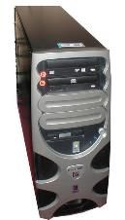
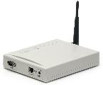
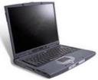

WEP
Shared key (statically configured master)
Uses a stream cipher

Slide 86
Working principle of WEP
Seed = IV+ Key
RC4 takes seed as input and produces KeyStream as output
IV(Initialization Vector) : 24 bits (Fixed)
Key : 40 bit or 104 bit
Seed : IV + Key (64/128bit)
Notes:
Key is shared between AP and Wireless (mobile) enabled device

Slide 87
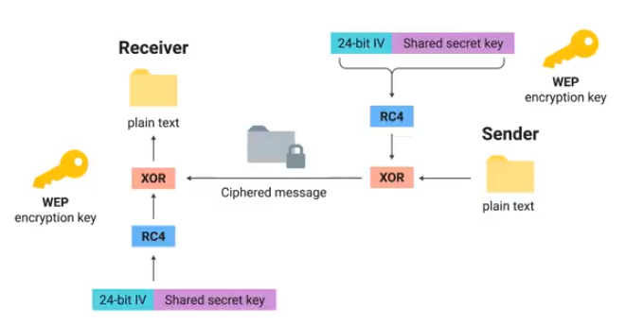

Slide 88
WEP encryption
P ⊕ RC4(K, IV)
Key ID byte
RC4 encrypted
IV
…
Payload
CRC-32
WEP uses the RC4 stream cipher to encrypt a TCP/IP packet (P) by xor-ing it with keystream (RC4(K, IV))

Slide 89
A risk of keystream reuse
IV, P ⊕ RC4(K, IV)
IV, P’ ⊕ RC4(K, IV)
If IV’s repeat, confidentiality is at risk
If we send two ciphertexts (C, C’) using the same IV, then the xor of plaintexts leaks (P ⊕ P’ = C ⊕ C’), which might reveal both plaintexts
If there is redundancy, if we can guess one plaintext, etc…

Slide 90
Spoofed packets: injection
Key ID byte
RC4 encrypted
IV
…
Payload
CRC-32
CRC is unkeyed
If attacker can intercept one value of RC4(k,IV) (through a plaintext/ciphertext pair, for instance), it is possible to forge a packet
C’ = < M’, CRC(M’) > ⊕ RC4(k, IV)
It implies reuse of IV, but this is permitted by the protocol
P ⊕ RC4(K, IV)
Arbitrary injection of packets is possible
Notes:
The CRC is performed on the plaintext but not on the ciphertext. CRC was designed to detect random errors in the message but not to prevent from any harmful attacks.

Slide 91
WEP conclusions
Security architecture does not meet its goals
No confidentiality
Plaintext may be recovered because of IV reuse
No integrity
Arbitrary modification or injection of messages is possible
And… RC4 actually turns out to not be as secure as previously thought
Software is available so you don’t need any expertise
Now you understand why we don’t use WEP here
… but many people still do!

Slide 92

WPA2
WPA2 certification began in 2004
AES (Advanced Encryption Standard) replaced RC4
CCMP(Counter mode with Cipher block chaining Message authentication code Protocol) replaced TKIP
RADIUS server authentication

Slide 93
Network Security Policy

Slide 94
This lecture’s agenda
Objective
Understanding the content of security policy document
Understanding the necessity of security policy
Understanding the structure of a Security Policy
Overview of Roles and Responsibilities

Slide 95
Structure of a Security Policy
Policy documents are often broken into a hierarchical structure:
Governing Policy
Intended Audience: Managers and technical staff.
The governing policy controls all security-related interactions among business units and supporting departments in the company.
Technical Policy
Intended Audience: Security staff members.
These policies are more detailed than the governing policy and are system-specific or issue-specific (e.g., access control and physical security issues are described in a technical policy.)
Broken down into technical areas including General, email, remote access, telephony, application usage, network usage, and wireless communication.
End-User Policy
Intended Audience: Employees, customers, and any other individual user of the network.
Covers all security topics that are important to end users.
Policies may overlap with technical policies.

Slide 96
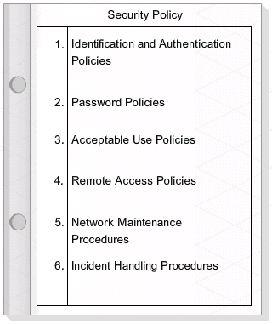
Security Policy

Slide 97
Managing Information Security
Administer User
Control Access
Information Protection
Manage Security
Information Security Policies and Standars

Slide 98
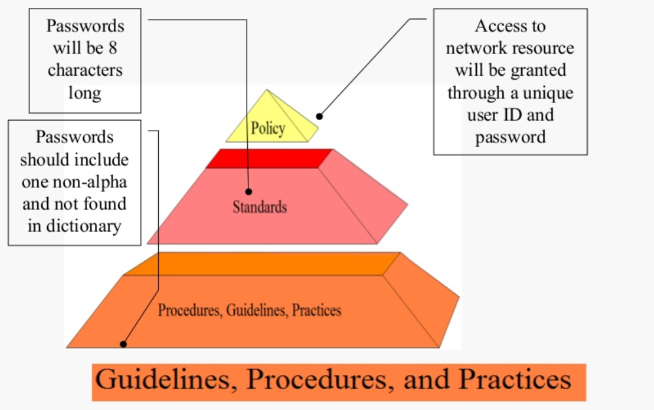
Security Policy, Standards and Guidelines

Slide 99
Elements of Policies
Set the tone of Management
Establish roles and responsibility
Define asset classifications
Provide direction for decisions
Establish the scope of authority
Provide a basis for guidelines and procedures
Establish accountability
Describe appropriate use of asset
Establish relationships to legal requirements.

Slide 100
Roles and Responsibilities
Chief Executive Officer (CEO)
Is ultimately responsible for the success of an organization.
All executive positions report to the CEO.
Chief Technology Officer (CTO)
Identifies and evaluates new technologies and drives new technology development to meet organization objectives.
Maintains and enhances the enterprise systems, while providing direction in all technology-related to support operations.
Chief Information Officer (CIO)
Responsible for the information technology and computer systems that support enterprise goals, including successful deployment of new technologies and work processes.
Small- to medium-sized organizations typically combine the responsibilities of CTO and CIO into a single position.
When an organization has both a CTO and CIO, the CIO is generally responsible for processes and practices supporting the flow of information, and the CTO is responsible for technology infrastructure.

Slide 101
Roles and Responsibilities
Chief Security Officer (CSO)
Develops, implements, and manages the organization's security strategy, programs, and processes associated with all aspects of business operation, including intellectual property.
A major aspect of this position is to limit exposure to liability in all areas of financial, physical, and personal risk.
Chief Information Security Officer (CISO)
Similar to the CSO, except that this position has a specific focus on IT security.
CISO must develop and implement the security policy, either as the primary author or management of authorship. In either case, the CISO is responsible and accountable for security policy content.

